Slide 1
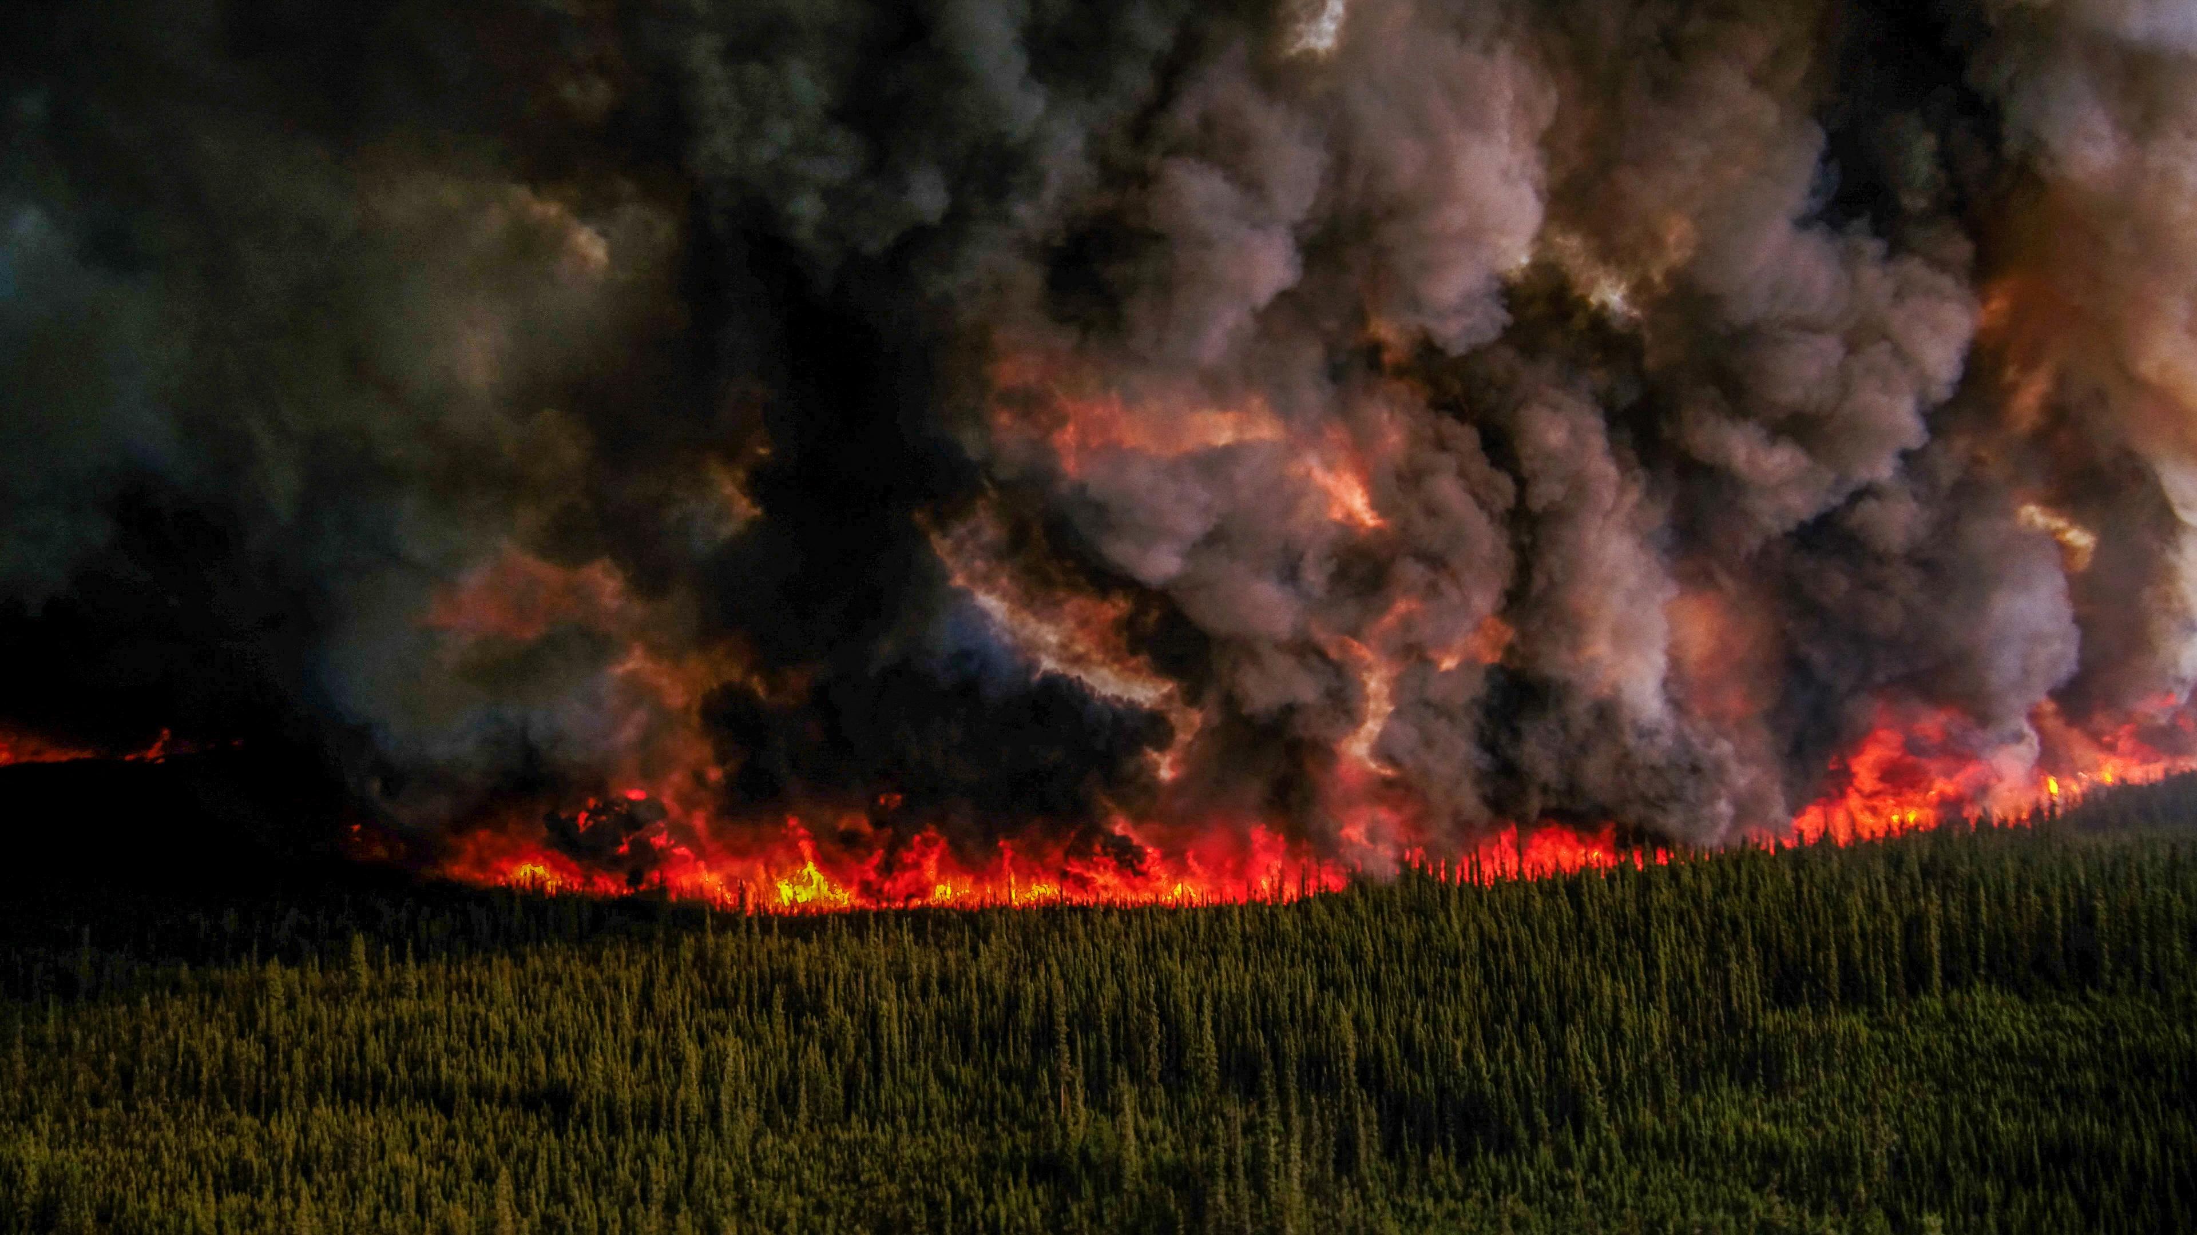
WILDLAND FIRE IN THE 21ST CENTURY:
CONSEQUENCES OF INACTION AND A PATH FORWARD
Kee Tas Kee Now Workshops: Wildfire Mitigation % Carbon Management
May 6 & 7, 2026
Edmonton, AB
Robert W. Gray
Wildland Fire Ecologist
R.W. Gray Consulting Ltd/USDA Forest Service Pacific Northwest Research Station

Slide 2
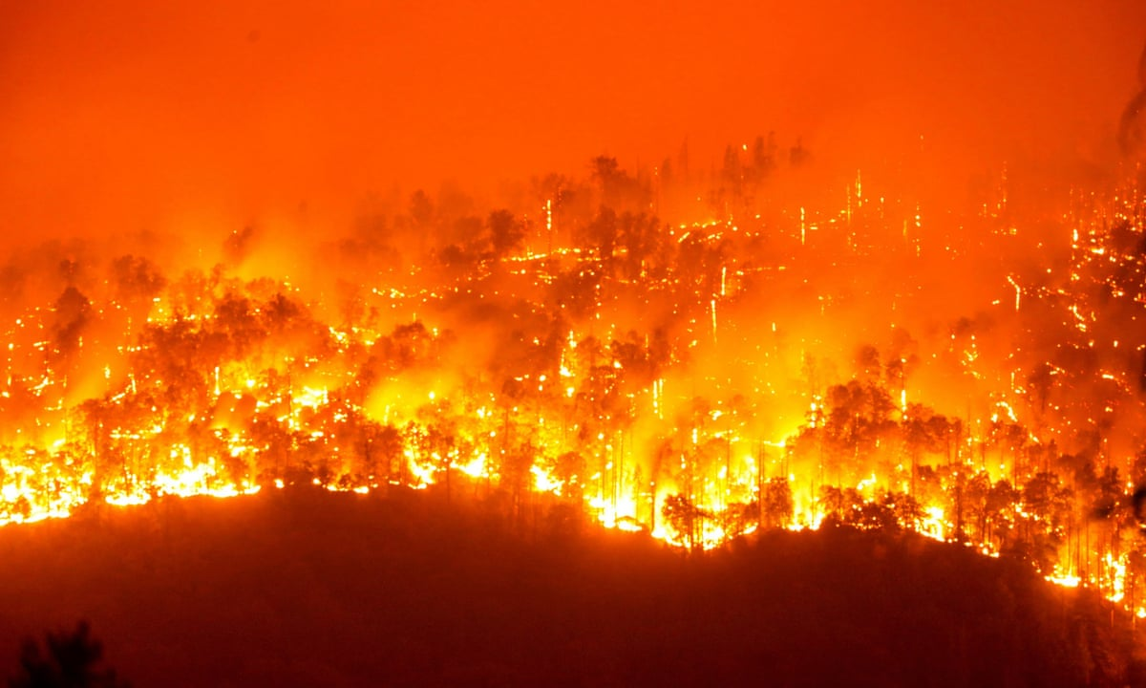
There is an inevitability to wildfire that we seem incapable of accepting….
Gabriel Kirkpatrick Mann,
Director of the 2023 documentary “Hotshot”

Slide 3
Future Fire

Slide 4
The Wildfire Crisis In Alberta

Slide 5
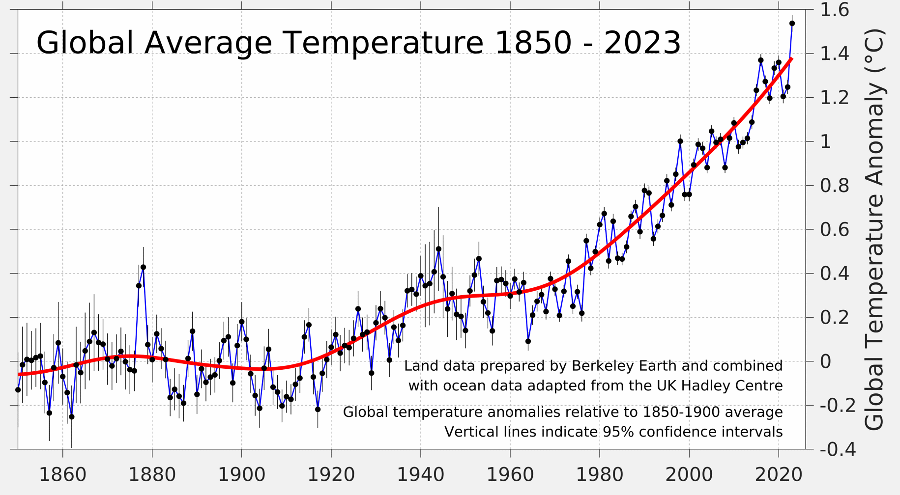
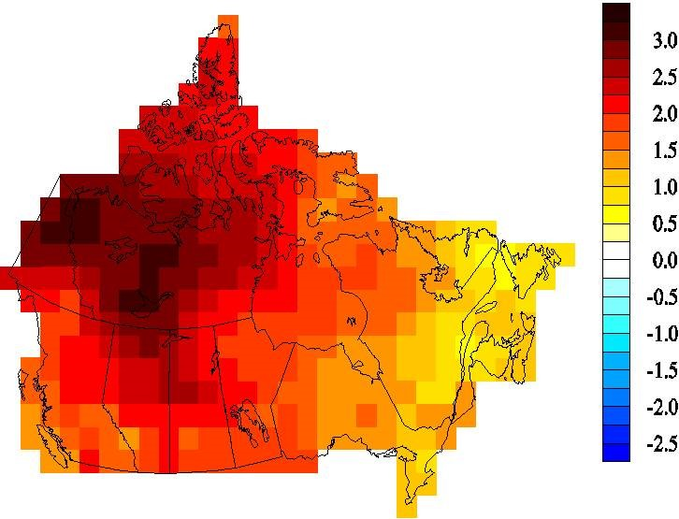
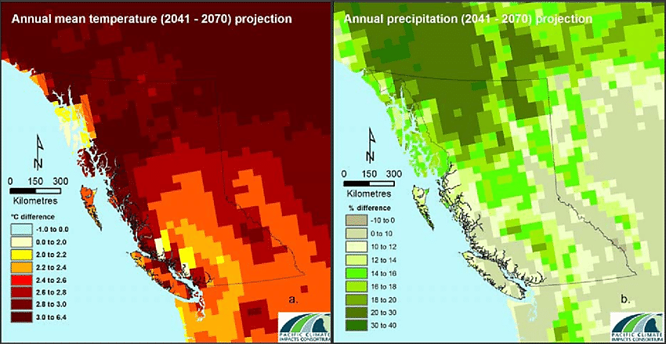

Slide 6
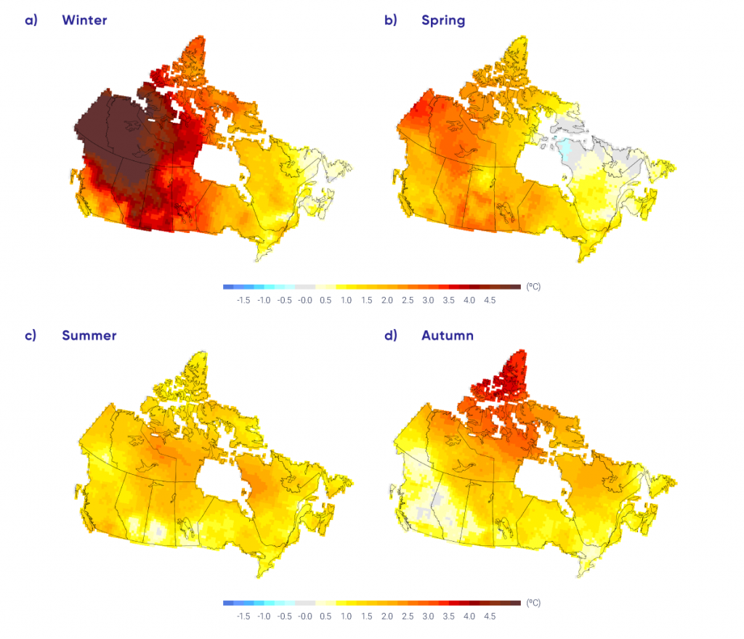
Later start to winter snows, and earlier snow melt
Warmer winters and reduced snowpack,
Very low late season water flows,
Drought impacts,
Access to water for fire suppression will become more of an issue

Slide 7
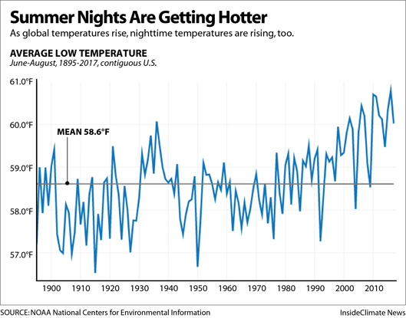
Changes in temperature and relative humidity
Warmer daytime temperatures
Lower daytime relative humidity
Higher min nighttime temperatures (poor overnight recovery)
Lower maximum nighttime relative humidity (poor overnight recovery)

Slide 8
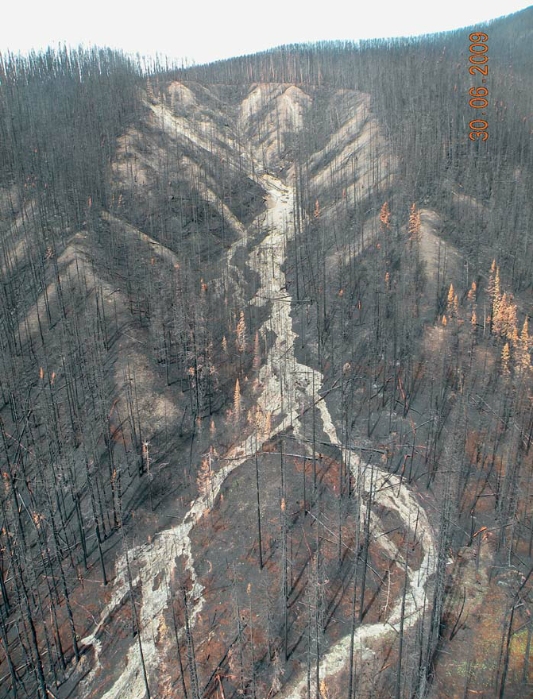
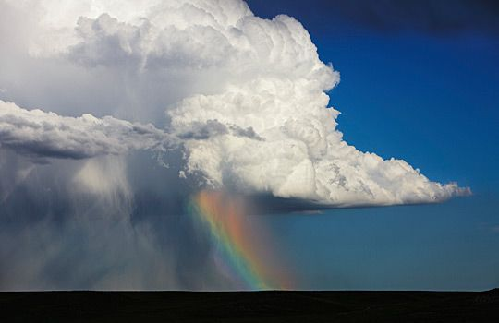
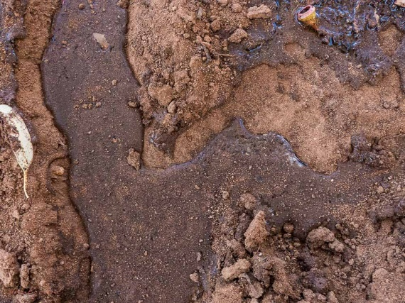
Less precipitation during the fire season and higher incidence of strong convective storms

Slide 9
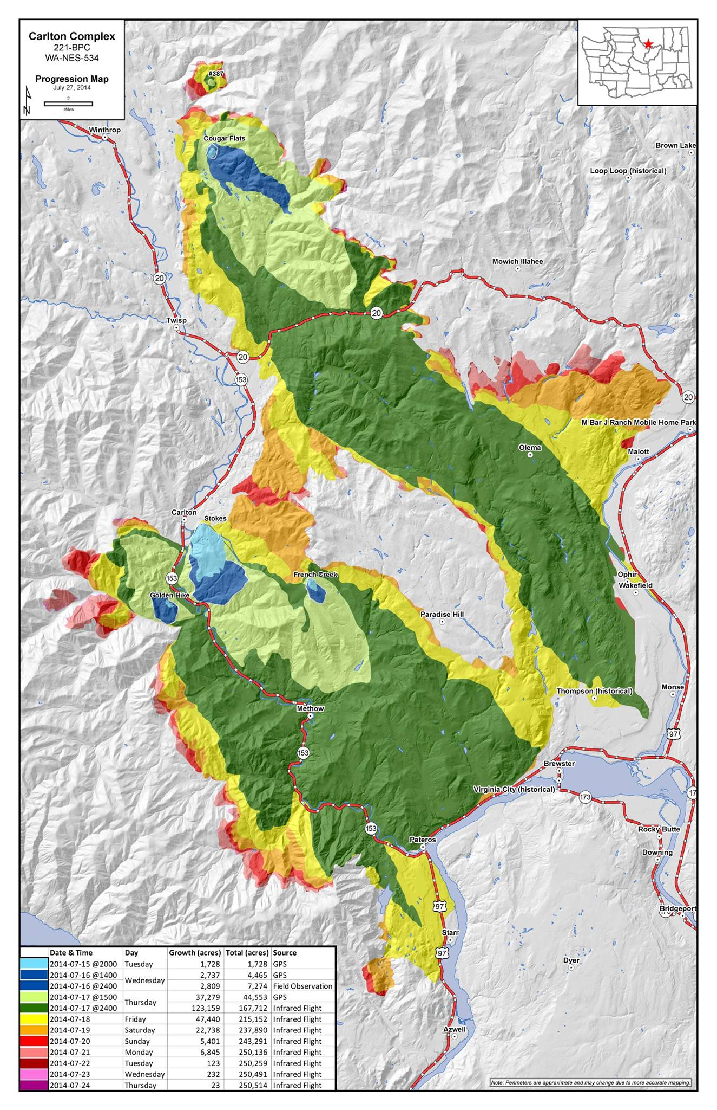
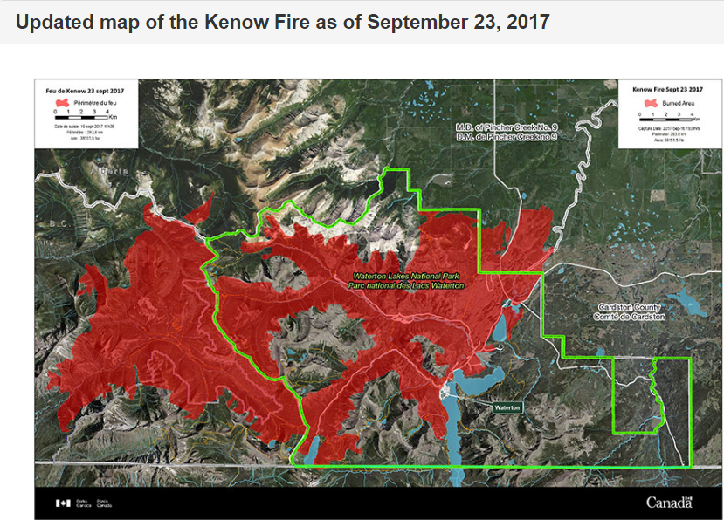
Higher incidence of strong wind events
53 km/6 hrs
= 156 m/min

Slide 10
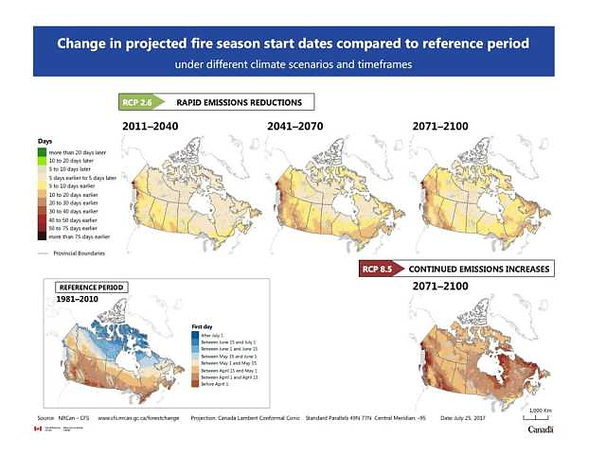
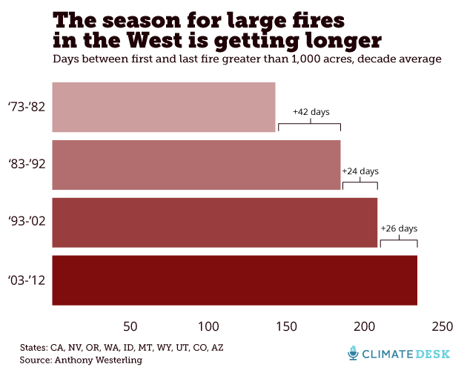
Longer fire seasons

Slide 11
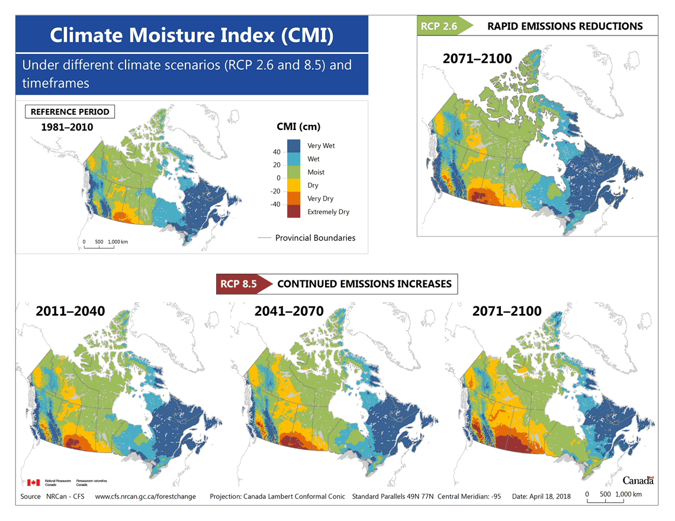
Drought

Slide 12
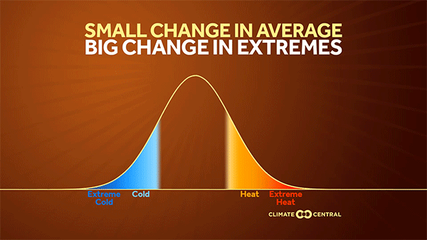
Future Trends

Slide 13
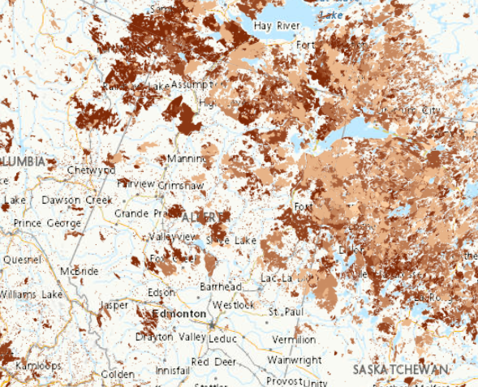
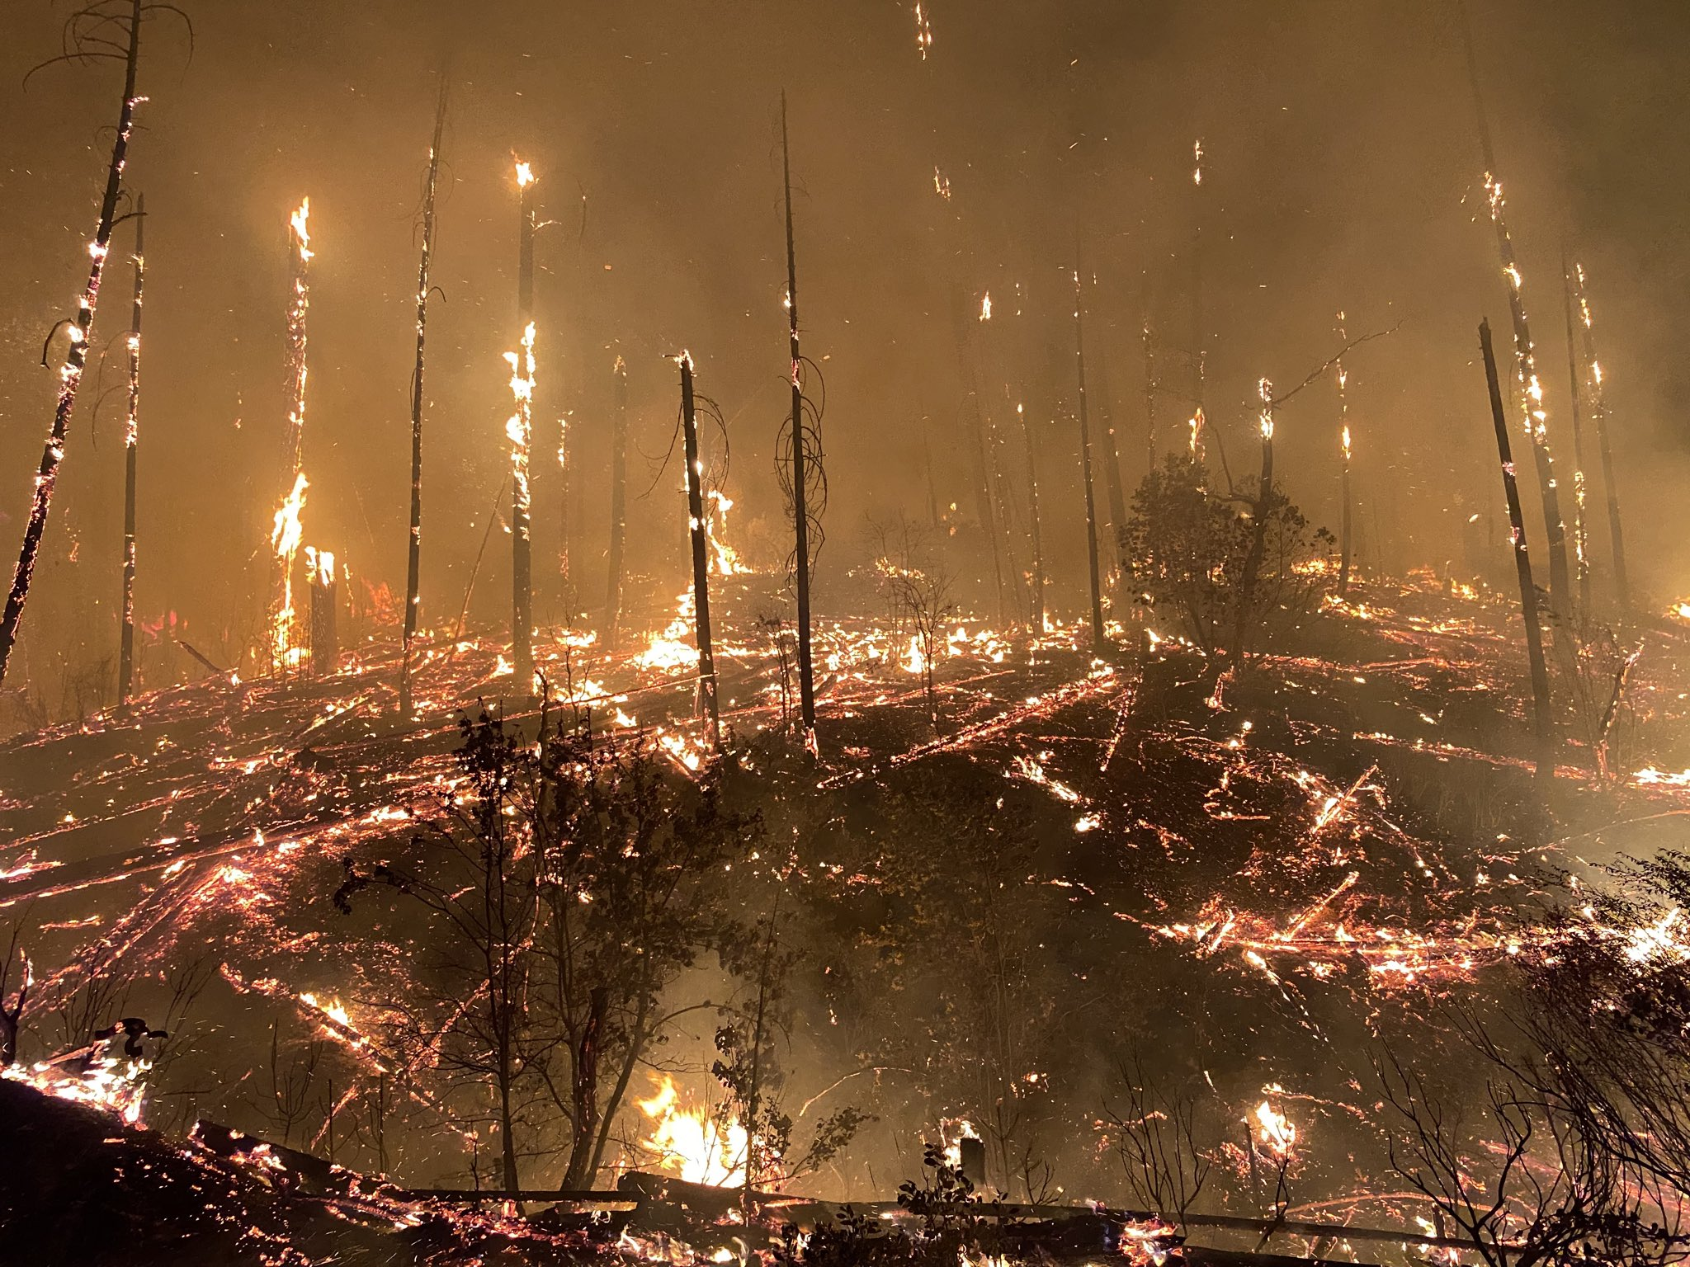
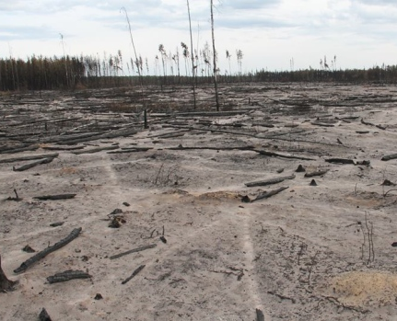
Hot, Dry and Windy….but you still need fuels!

Slide 14
The Cost of Inaction

Slide 15
(A) Direct + Indirect + Minor Mitigation
Cost
Time

Slide 16
Annual Direct Expenditures for AB (Suppression): 2013-2025 Plus Trend Line

Slide 17
Mean Annual Contingency (Threats to the Fiscal Plan)

Slide 18
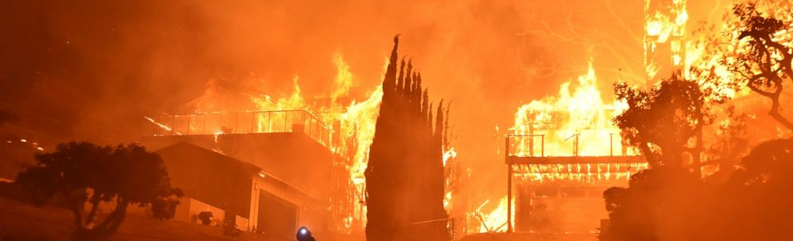
Economic Burden from Wildfire
Direct (suppression) + indirect (home/business losses, human health, evacuation, infrastructure impacts from post-fire flooding, etc.)
2016 annual burden in US: $71 billion to $348 billion
2024 annual burden in US: $394 billion to $894 billion
Don’t have comparable data for Canada
US study: total fire cost is 2-30 times direct cost
Canadian study (four fires): total fire cost is 1.5-20 times direct cost

Slide 19
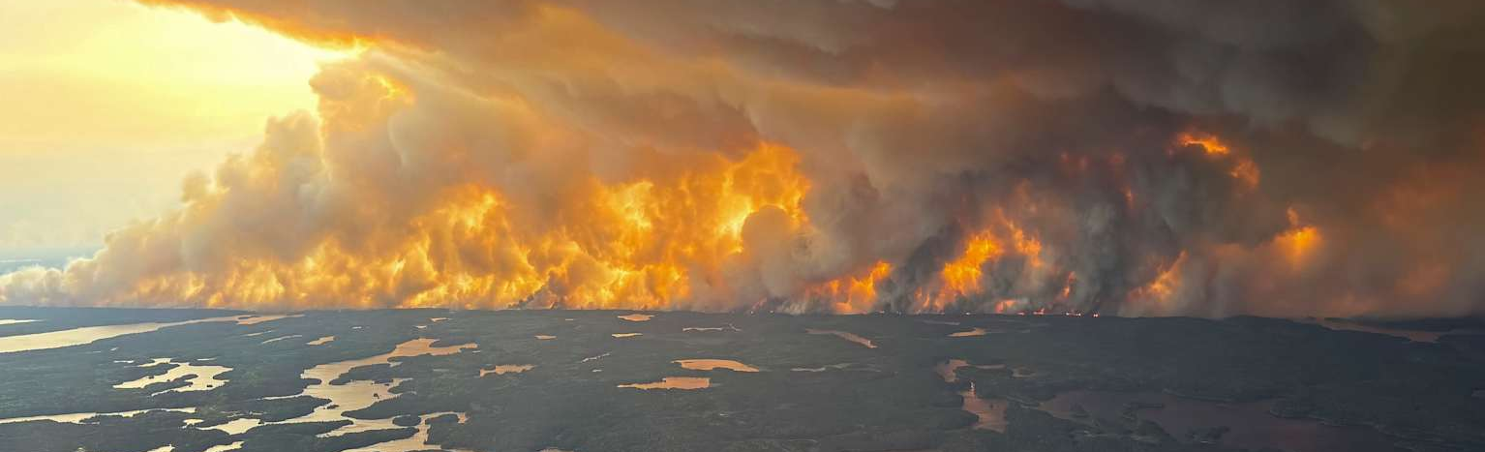
Indirect Cost: Smoke
Approximately 82,100 deaths worldwide attributed to smoke from 2023 fires in Canada (33,000 in US and 8,300 in Canada)(Zhang et al. 2025)
2020 to 2024 US workers in retail, wholesale, transportation, construction, mining and agriculture industries lost $1.1 trillion in lost wages due to exposure to wildfire smoke (Bloomberg Intelligence)
By 2050 wildfire smoke cause 71,000 excess deaths annually in the US representing $608 billion in damages (Nature)
Mortality associated with fine particles (PM2.5) may be underestimated by 93% (Lancet Planetary Health 2025)

Slide 20
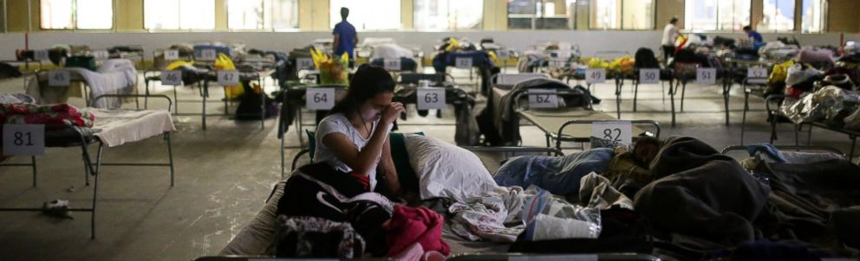
Indirect cost: human physical and emotional health
Indigenous communities make up 42% of all wildfire evacuations in Canada
Some communities have been evacuated multiple times over the last several decades
Trauma counselling services are often lacking for remote, rural communities
Physical and mental toll of wildfire fighting is significant with increases in substance abuse, relationship breakdown, anxiety, depression and suicide.

Slide 21
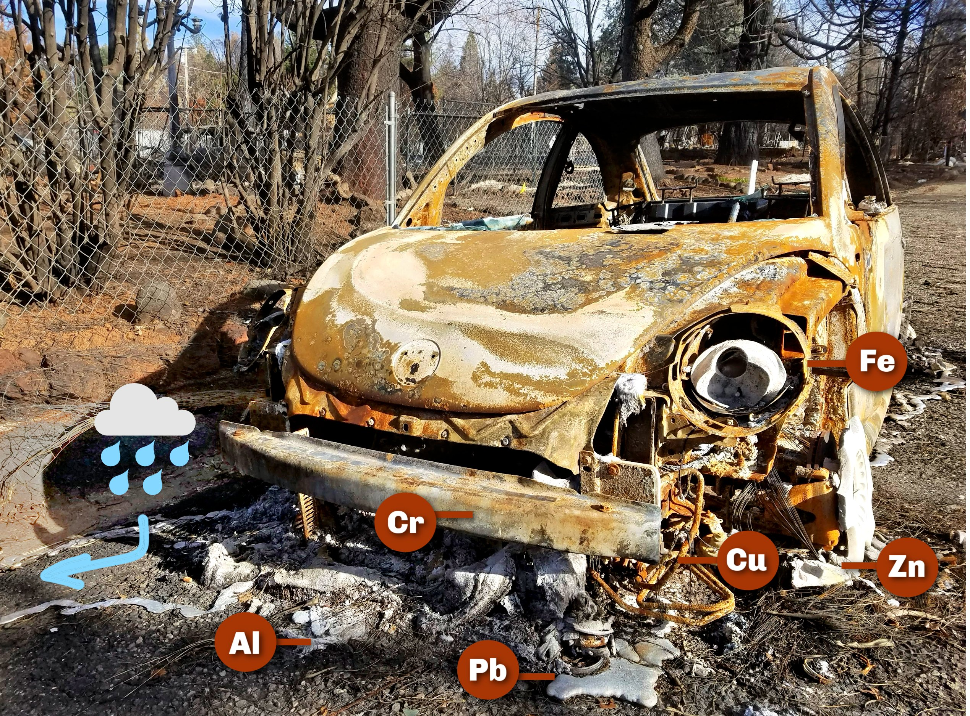
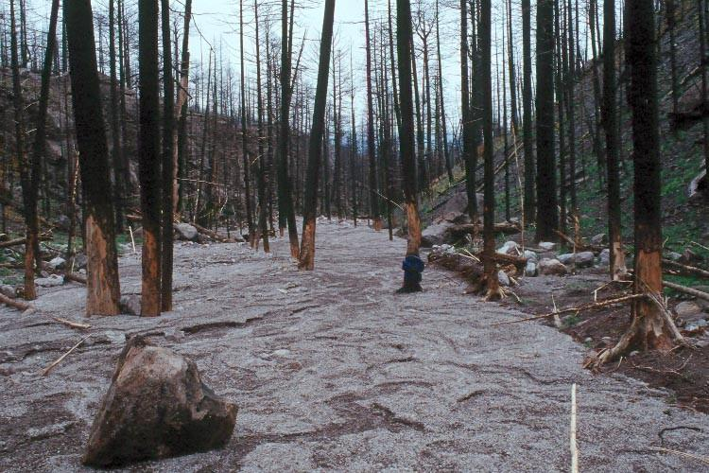
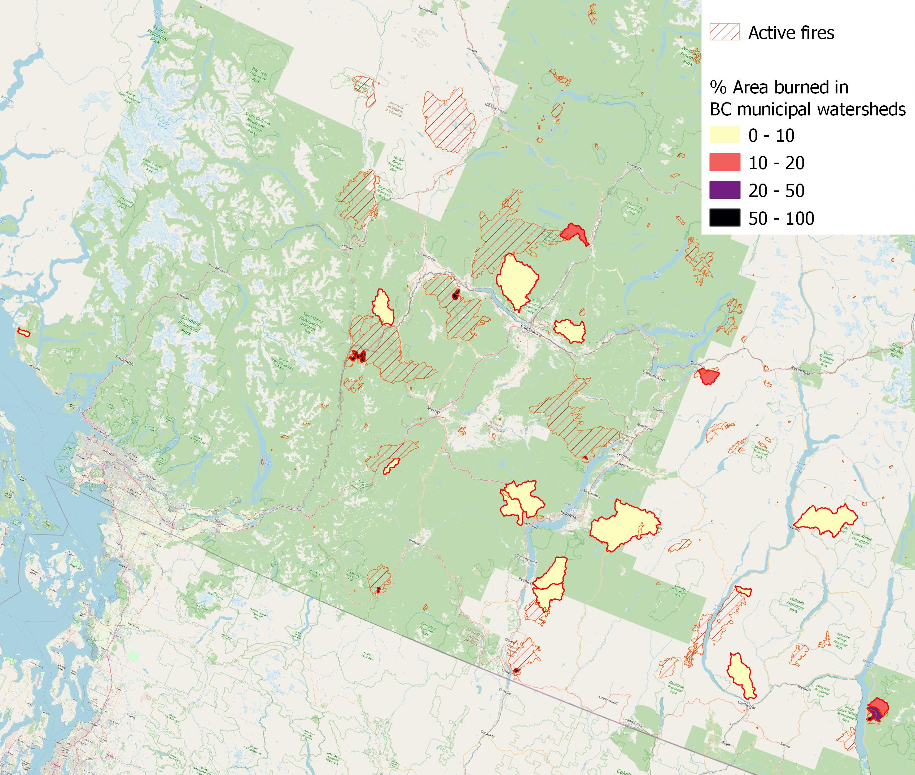
WATERSHEDS, WATER QUANTITY, AND WATER QUALITY
Loss of >20% of the canopy cover in a watershed will trigger a hydrological response
  Increased peak flows
  Decreased late season flows
  Increased nutrient load
Other factors:
  Soil hydrophobicity
  Soil type (some more erodible than others)
  Watershed topography (steep vs flat)
As of August 19, 29 watersheds were burned; 12 burned at >20% area and 9 burned at >75% area.

Slide 22
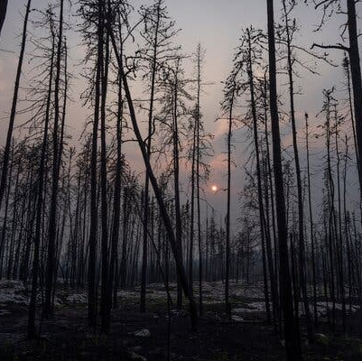
Indirect Cost: Forest Sector
Since 2017, 15-20% of the BC THLB has been significantly affected by wildfire
Additional % lost to bark beetles and past harvest (some overlap) – if the trend continues forest sector will be unsustainable and uneconomical (already unsustainable and uneconomical in some regions)

Slide 23
A Path Forward

Slide 24
“The landscapes of the future have to mimic the landscapes of the past.”

Slide 25
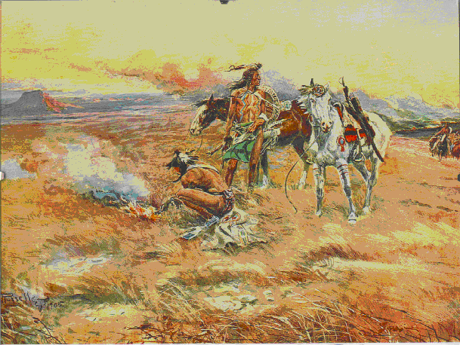
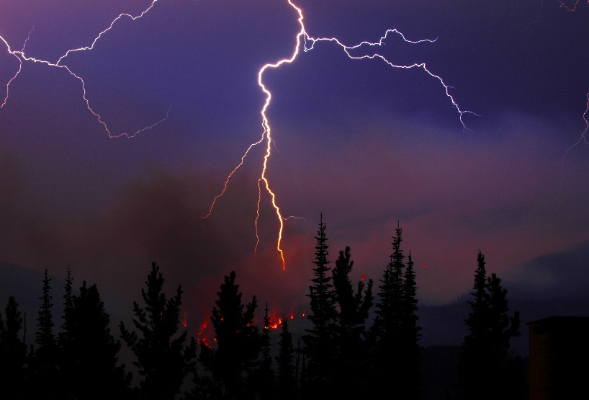
LANDSCAPES EXPERIENCED A LOT OF FIRE, BUT BECAUSE OF THAT, MOST FIRES WERE SMALL

Slide 26
Critical threshold of area treated
(A) Direct + Indirect + Minor Mitigation
Cost
Lag effect – don’t start to see gains until a certain threshold of area treated
(B) Direct + Indirect + Major Mitigation
Time

Slide 27
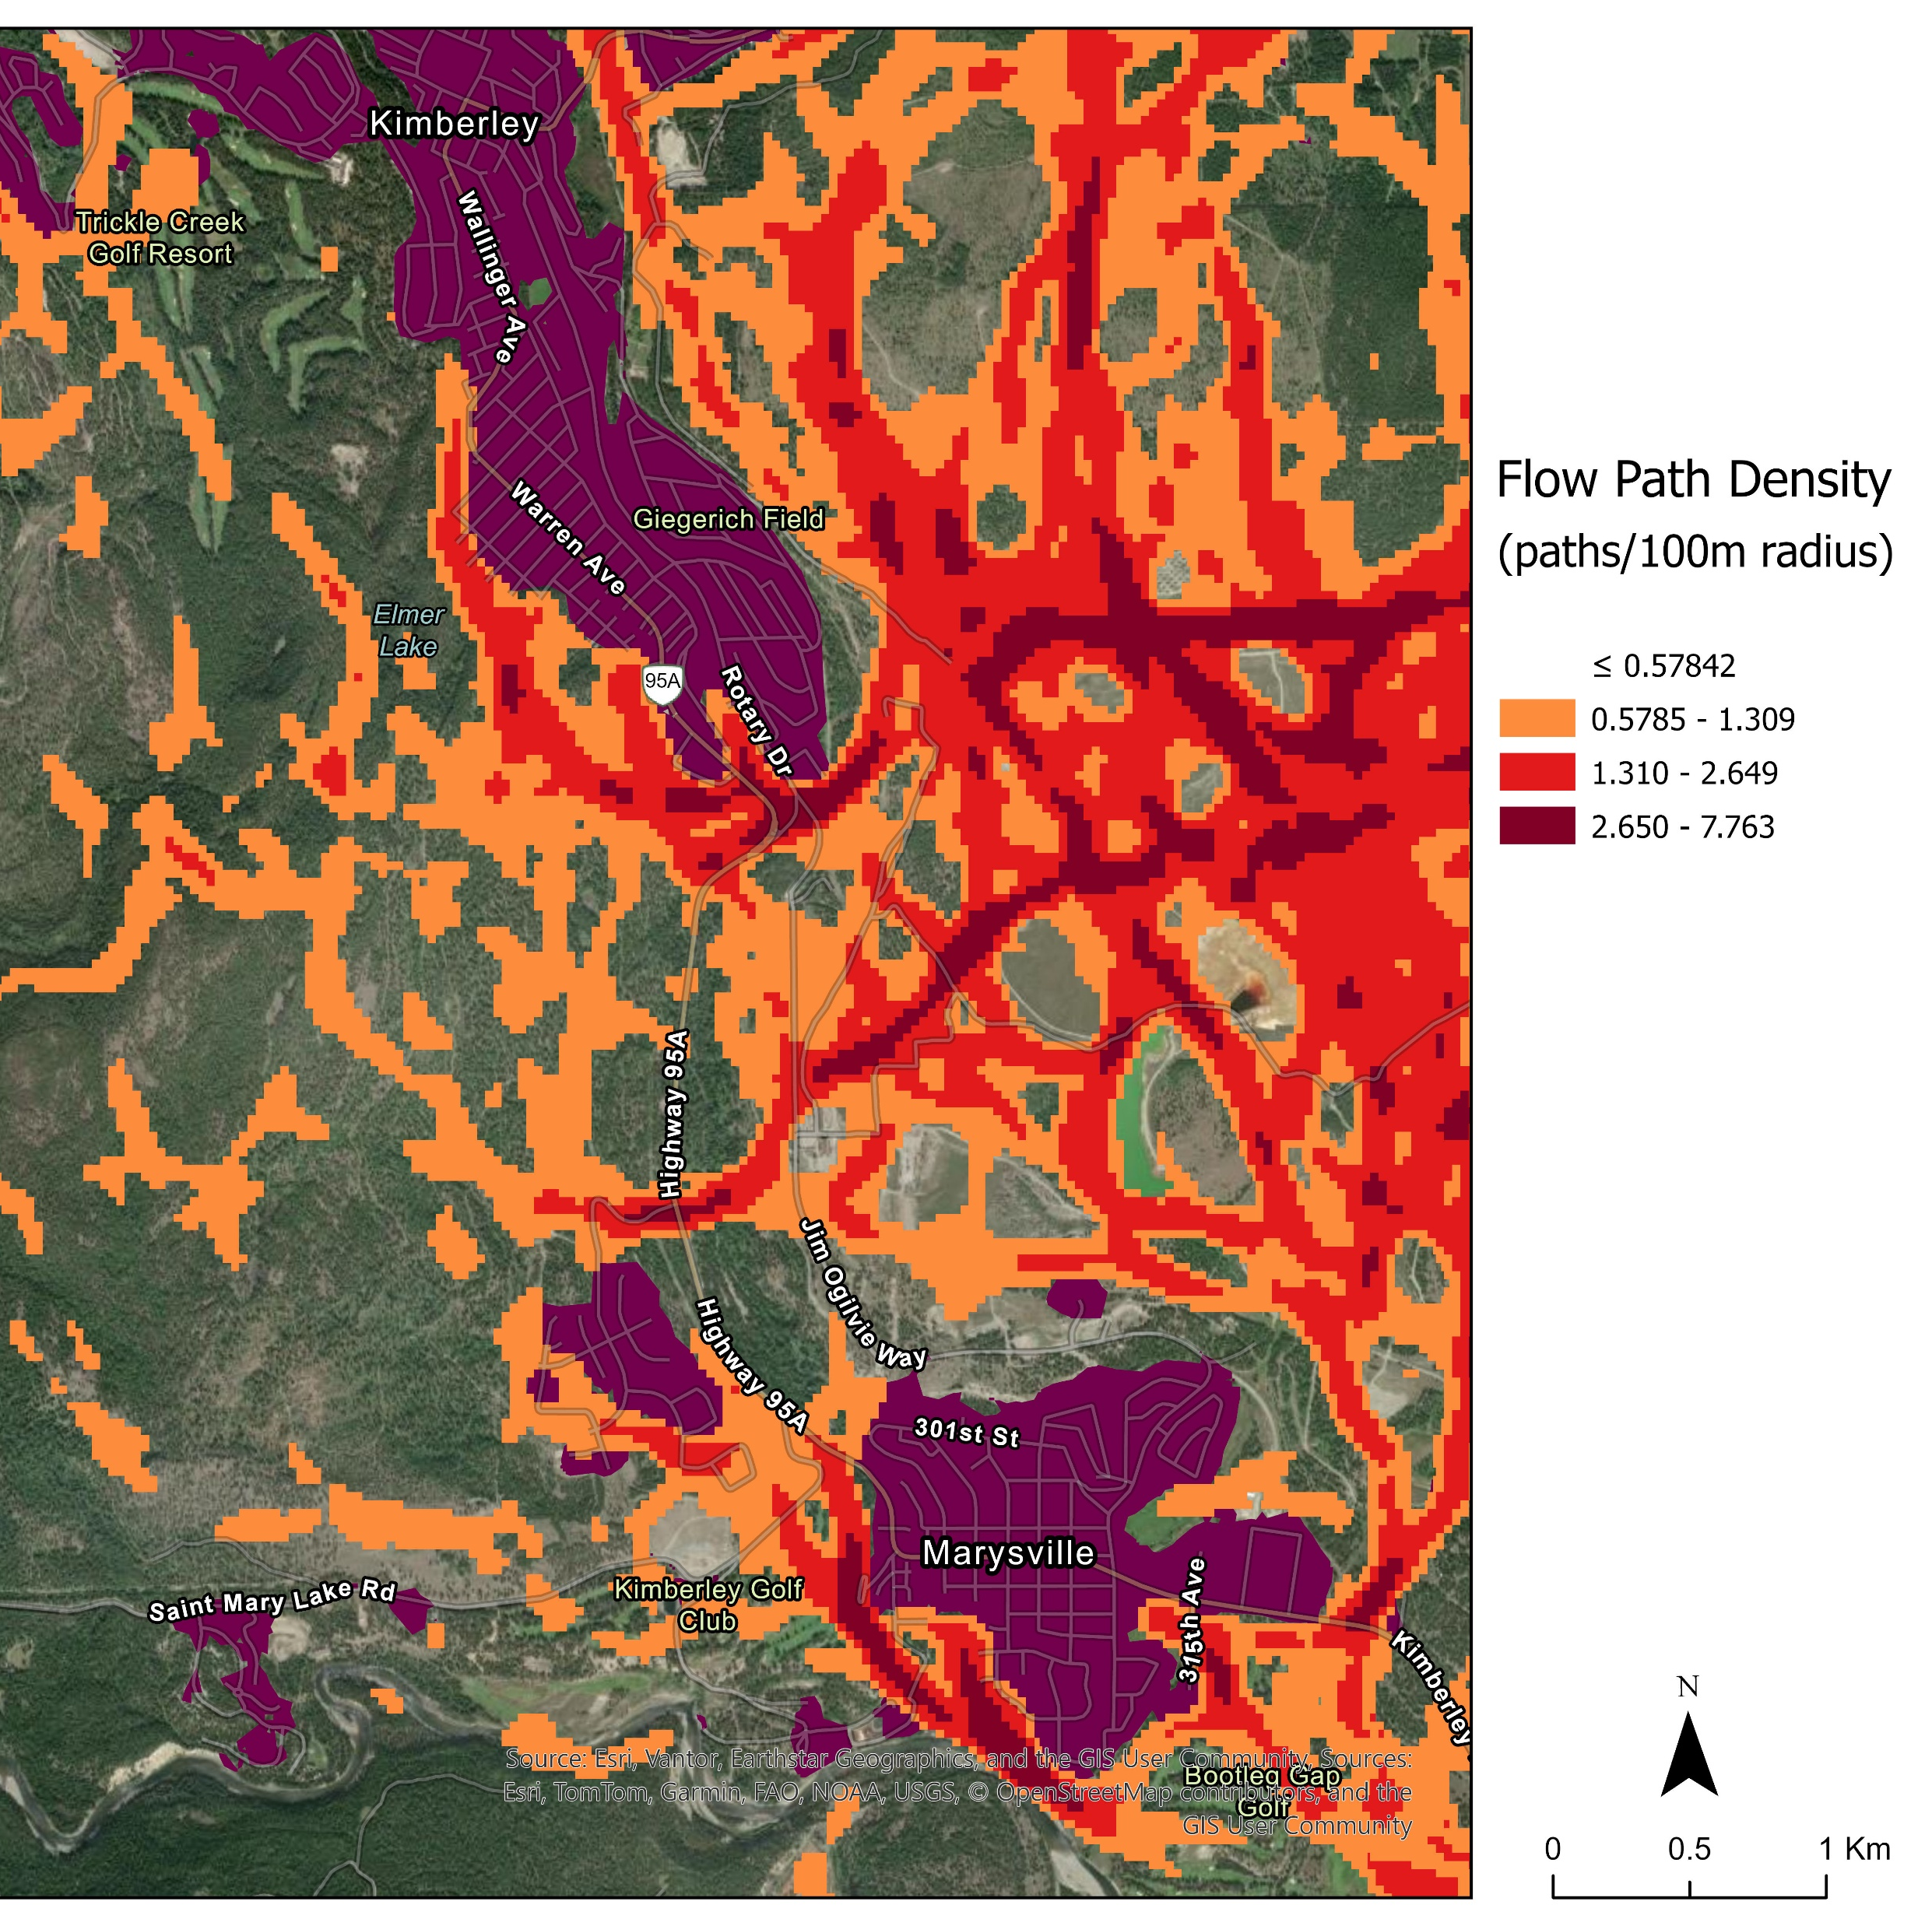
Need Significant Pace And Scale But Don’t Need To Treat Everywhere
Fire flow pathways
Fuel treatments – not just harvesting
Critical threshold of treatment: 35-50%
Priorities are communities, water and critical infrastructure
Need to be intentional in what we do and where – reduce the area burned at high severity is the goal and we should be focused on targets

Slide 28
The more fences there are, the slower fire spreads. The advantages of slowing fire spread:
Time for suppression resources to get there,
Time for weather to change,
Average fire size starts to decrease.

Slide 29
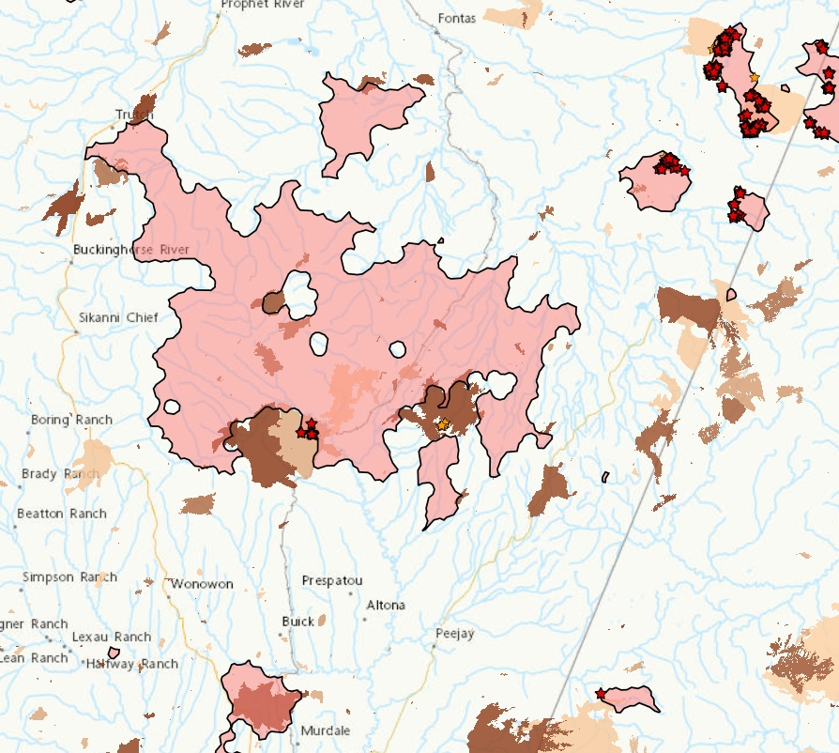
Natural fences: Recent wildfires
These recent fires in the area of the Donnie Creek Fire impeded it’s forward progress.
This older burn scar did not affect fire spread.

Slide 30
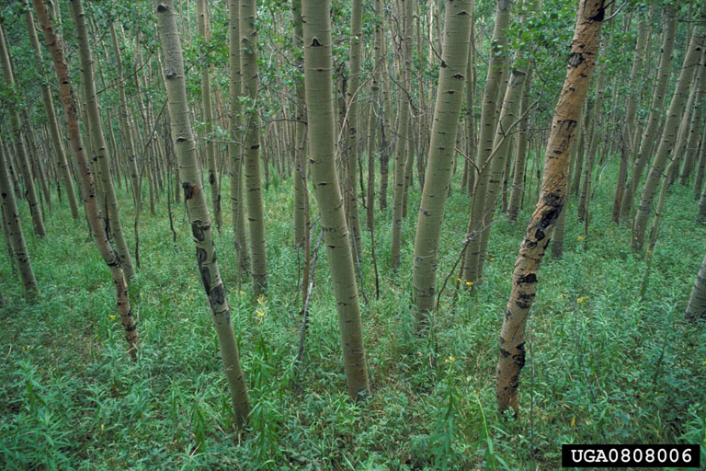
Natural fences: Hardwood forests
Closed canopied hardwood forests (especially aspen), exhibit lower temperature, higher humidity, lower midflame windspeed, and higher dead and live fuel moisture. All of these features affect flammability.
However, young and old aspen and aspen in the spring and fall exhibit higher flammability.

Slide 31
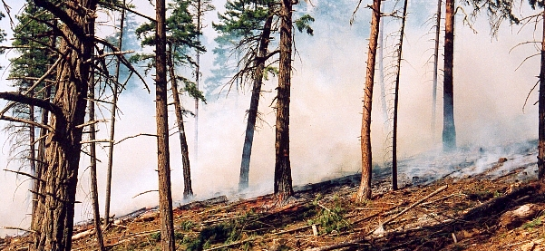
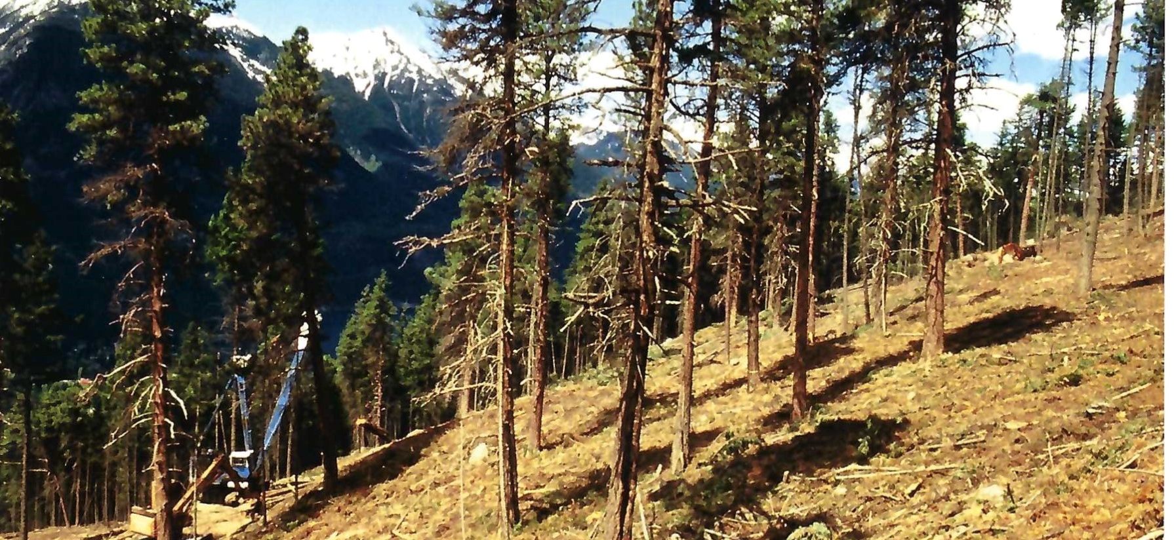
Man-made fences: fuels management
Timber harvest, whether clearcut or partial cut, followed by prescribed fire, will initially stop fire spread, then it will function to slow fire spread, and then eventually, it will no longer do either.
The period of effectiveness is highly variable and depends on how well the burn met it’s objectives and the ecosystem and climate (i.e., how quickly fuels re-accumulate).

Slide 32
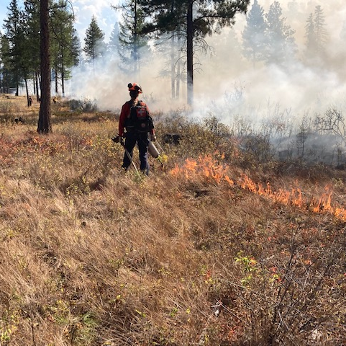
Man made fences: landscape-scale cultural and prescribed fire
Landscape-scale prescribed fire is an important tactic and can be used in areas where an initial fuel removal treatment such as mechanical thinning is not feasible.
Appropriate where the treatment matches the fire ecology of the ecosystem.
Can be used effectively to treat large areas but maintenance is critical.

Slide 33
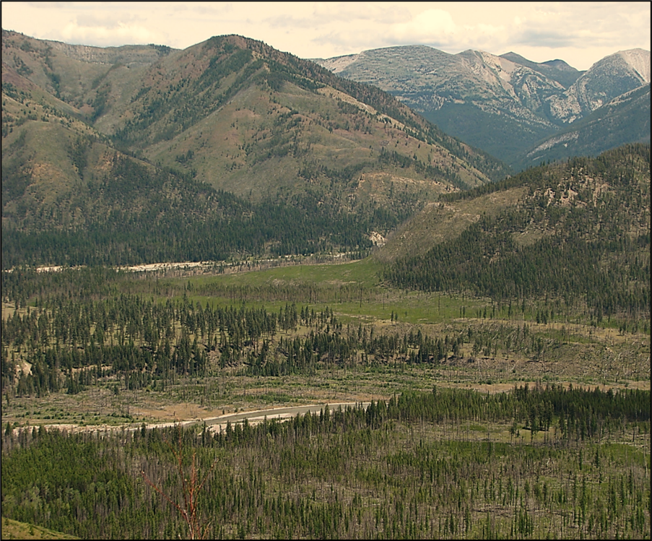
Manage for Dynamic Landscapes
Fire doesn’t recognize static reserves or ownership boundaries
Treat for the greatest benefit vs not where constrained
Take an “all lands approach”
  On public lands, treat static reserves
  Enable the treatment of uneconomical stands
  Incentivize the treatment of private lands
Notes:
Bob

Slide 34
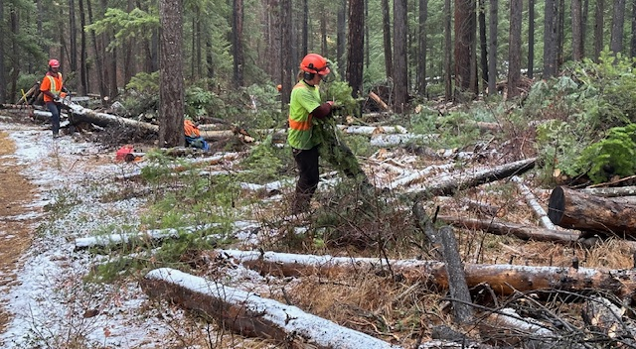
Build and Maintain Local Capacity via Guardian Programs
Invest in workforce to address wildfire threat at the appropriate pace and scale
Long-term stable funding for local-to-regional wildfire threat reduction will:
  enable development of highly-skilled, motivated workforce
  plan and carry out fuel treatments year-round
  contribute to emergency response and suppression during fire season
Investment dividends include increased local employment, tax base, support for businesses associated with the bioeconomy, and reduce fire threat
Notes:
Dominik

Slide 35
In Summary
Future is going to be difficult….
If we continue with the status quo approach the costs are only going to rise….
We need to dramatically increase the pace and scale of mitigation and I believe we can find way to do that!

